Slide 1
Day 5
HTTP API, Swagger & More

Slide 2
Dependency Injection - Summary
A design pattern where dependencies are provided to a class, rather than the class creating them
Code is now more modular, testable and maintainable
Loose coupling
Easier testing
Single responsibility
Lifecycle management

Slide 3
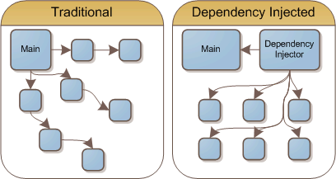
Dependency Injection

Slide 4
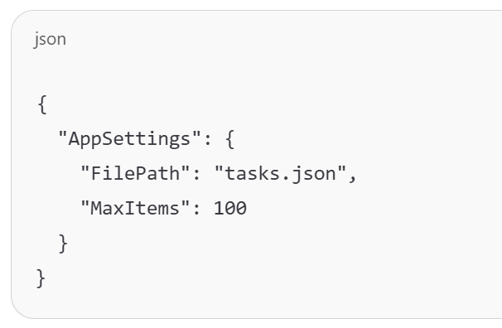
JSON
Javascript Object Notation
A textual representation of an object
Used to pass data between entities through the internet
We’ll use it to receive and send data about our TODO items
It’s up to the “Client” to decide how it displays it

Slide 5
HTTP Standards – Requests
GET – Receive something. No body. Parameters in request.
POST – Add a new object. Data in body.
PUT – Update an object. Data in body.
DELETE – Deletes an object
Notes:
Difference between POST and PUT?
Not enforced, but a standard

Slide 6
HTTP Standards – Requests
GET – Receive something. No body. Parameters in request.
POST – Add a new object. Data in body.
Twice the same request – The second should fail
PUT – Update an object. Data in body.
Twice the same request – Twice the same response
DELETE – Deletes an object

Slide 7
HTTP Standards - Responses
2XX – OK
3XX – Redirects (we won’t use this)
4XX – Client error. If the user sends the same request again, it will fail again. No point in retrying. (429*)
5XX – Server error. The user should retry the request.
Notes:
429 – Timeout Error
Not enforced, but a standard

Slide 8
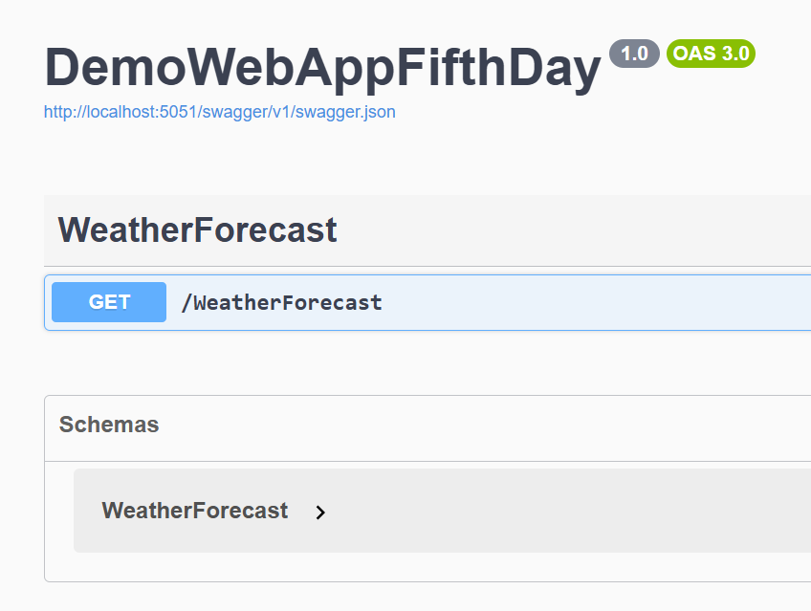
Swagger
A JSON document that allows computers and humans to describe an API
Can be automatically or manually generated
Automatic in C# ☺
Creates a nice UI for development (and production…)

Slide 9
LET’S SEE THIS IN ACTION
Notes:
I do this while they look:
Create an ASP,NET Core Web API
Enable OpenAPI support
Do not use top-level statements
Use controllers
Remove “Configure for HTTPS”
Explain what they see
Program
Remove AddEndpointsApiExplorer
useSwagger – not only in development mode
Controller
Attributes
ApiController
Route
HttpGet

Slide 10
Attributes
[XXX] before class/methods/parameters definition
Provide Metadata to that entity
[Fact] – for testing
[Obsolete] – for marking a function as obsolete
They don’t DO anything, but only provide Metadata
Other function might do something with it (like xUnit and [Fact])

Slide 11
Reflection
Look at entities Metadata while running
A way to find classes, methods and create or invoke them
Yes, private functions as well!
You must have a very good reason to do this!

Slide 12
Reflection + Attributes
When setting attributes, we are expecting some kind of reflection to read them and do something about them
xUnit and [Fact] – We saw
DI and [ApiController] – Now we’ll see
Json and [JsonProperty] – Later we’ll see

Slide 13
LET’S SEE THIS IN ACTION
Notes:
Continue
Explain what they see
Controller
Attributes
ILogger
ApiController
Route
HttpGet
Run!

Slide 14
TODO List Web App!
Notes:
Create the project
Convert the menu to API endpoints
Get all tasks
Get a task by ID
Create a task
Update a task
Delete a task

Slide 15
Client Side
How to make requests?
We need to send Http requests to our server
Introducing: IHttpClientFactory

Slide 16
IHttpClientFactory ❤️ HttpClient
Receive IHttpClientFactory in the constructor
Use httpClientFactory.CreateClient() to receive the HttpClient instance
Use “using” when sending a Http Request
Use PostAsJsonAsync(“”, <object>)
Use ReadFromJsonAsync<object>()

Slide 17
How to test?
We don’t do IO, right?
But we want to test our endpoints!
Microsoft to the rescue!

Slide 18
What’s next?
Create different types of tasks
Change the JSON representation of Id, Title and Description
Get – Add filter in request path (?orderby, ?startswith)

